Slide 1
Digital Advertising Landscape Analysis of Higher Education (A case of New Delhi Institute of Management)
Mohak Sehgal, Student of BBA 3rd Year, NDIM;
Dr. Ambika Rathi, Associate Professor, Marketing, NDIM;
Ankur Budhiraja, Assistant Professor, Marketing, NDIM

Slide 2
Objectives
Institutions Considered
Approach
Outcome
Institutions Established Year/ Intro.
Questionnaire
Facebook
Instagram
Suggestions
Objectives
To understand and analyze the digital behavior of learning partners (Students) and faculty.
To analyze the digital advertising landscape analysis of NDIM.
To understand and analyze the social media strategies adopted by the colleges to engage with partners in learning (Students).
1

Slide 3
Objectives
Institutions Considered
Approach
Outcome
Institutions Established Year/ Intro.
Questionnaire
Facebook
Instagram
Suggestions
Institutions Considered
For the purpose of the study, the primary institution taken is New Delhi Institute of Management (NDIM). While During the course of the research, a theoretical comparative analysis will be attempted between NDIM & Trinity Institute of Professional Studies (TIPS) another institute affiliated to Guru Gobind Singh Indraprastha University (GGSIPU).
The other main reason to select these institutions because they are very active on social media platforms.
2

Slide 4
Objectives
Institutions Considered
Approach
Outcome
Institutions Established Year/ Intro.
Questionnaire
Facebook
Instagram
Suggestions
Approach
We will understand the digital behavior of individual by analyzing how much time they spent on digital platform, on which digital platform they are more active and many more. For understanding the behavior a open & close ended questionnaire is made.
We will take a sample size of around 150 respondents and all the 150 respondents will be covered through online survey. The target group (TG) for the survey will be NDIM Students and Faculty.
We will obtain data by going through the social media pages of the institutions and try to understand the type of content mix they are using to engage with the audience.
It will help us to understand positioning and communication of the respective institution. We will also analyze how institutions are using their different social media platforms like Facebook, Instagram as a part of their digital marketing strategy.
3

Slide 5
Objectives
Institutions Considered
Approach
Outcome
Institutions Established Year/ Intro.
Questionnaire
Facebook
Instagram
Suggestions
Approach Continue…
The study will be conducted by keeping below parameters in the mind: -
1)- Fan following of the page
2)- Frequency of content
3)- Content Mix
4)- Types of content on each platform: - videos, GIFs, Static
4

Slide 6
Objectives
Institutions Considered
Approach
Outcome
Institutions Established Year/ Intro.
Questionnaire
Facebook
Instagram
Suggestions
Outcome
This study will help us provide an overview of digital strategy adapted by competitor institute and suggestions/recommendations and point of action for NDIM to improve their digital platforms.
5

Slide 7
Objectives
Institutions Considered
Approach
Outcome
Institutions Established Year/ Intro.
Questionnaire
Facebook
Instagram
Suggestions
Institutions Established Year
NDIM was established way back in 1992 and got affiliated to GGSIPU in the year 1999.
TRINITY was established in 2007 and got affiliated to GGSIPU in the same year itself.
6

Slide 8

Objectives
Institutions Considered
Approach
Outcome
Institutions Established Year/ Intro.
Questionnaire
Facebook
Instagram
Suggestions
New Delhi Institute of Management (NDIM)
NDIM has completed 25 glorious years and emerged as one of the premier business schools in the country. NDIM came into origin in 1992 and has been affiliated for its BBA programme to the prestigious GGSIPU right from its inception. It has now come a long way since its inception and strengthened itself by adopting an innovative pedagogic approach, so that the students not only become good managers but also develop leadership skills.
NDIM is a unit of a National level NGO, under a registered charitable society called Society for Employment and Career Counselling established to promote excellence in management education, research and managerial training.
7

Slide 9

Objectives
Institutions Considered
Approach
Outcome
Institutions Established Year/ Intro.
Questionnaire
Facebook
Instagram
Suggestions
TRINITY Institute of Professional Studies (TIPS)
T - Talented
R - Rational
I - Industrious
N - Newsmakers
I - Innovative
T - Technocrats
Y - Yielding
At TIPS, we render the illuminant light to enlighten the future prospects of future technocrats, journos, administrators and other such professionals in the real competitive world. For this, we provide all encompassing and all empowering education with the right mix of scholastic & co-scholastic activities rendered through effective teaching methodology imparted by dedicated and highly qualified faculty under the able guidance of the perseverant management.
8

Slide 10

Objectives
Institutions Considered
Approach
Outcome
Institutions Established Year/ Intro.
Questionnaire
Facebook
Instagram
Suggestions
Questionnaire
9
*Only Filled by NDIM Students and Faculty

Slide 11

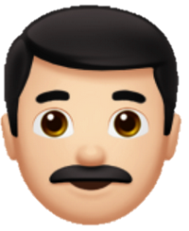

Objectives
Institutions Considered
Approach
Outcome
Institutions Established Year/ Intro.
Questionnaire
Facebook
Instagram
Suggestions
Respondent Profile
Age
There are 84 males and 66 Females in which 54% respondents are in the category of 18-20, 28% respondents are in the category of 21-25 and 18% are in the category of above 29.
10

Slide 12
Objectives
Institutions Considered
Approach
Outcome
Institutions Established Year/ Intro.
Questionnaire
Facebook
Instagram
Suggestions
Are you aware of the fact that institutions also advertise on social media?
All the respondents are aware about the fact that institutes also advertise on social media.
11

Slide 13
Objectives
Institutions Considered
Approach
Outcome
Institutions Established Year/ Intro.
Questionnaire
Facebook
Instagram
Suggestions
Do you read/ look for more information of institutions on Internet?
There are only 14% of the respondents who do not read any information regarding institutions but majority of the respondents (86%) read information regarding institutes on Internet.
12

Slide 14
Objectives
Institutions Considered
Approach
Outcome
Institutions Established Year/ Intro.
Questionnaire
Facebook
Instagram
Suggestions
How Important for you is the institution website?
Most of the respondents think that institutional website is most source of information. So, colleges must update their website.
13

Slide 15
Objectives
Institutions Considered
Approach
Outcome
Institutions Established Year/ Intro.
Questionnaire
Facebook
Instagram
Suggestions
What sort of marketing/ advertising you think is more important for an institution?
The most of the respondents think that word of mouth and digital marketing is important for an institute. Thus, from my research it is also proved that institute should give due importance to the digital platforms.
14

Slide 16
Objectives
Institutions Considered
Approach
Outcome
Institutions Established Year/ Intro.
Questionnaire
Facebook
Instagram
Suggestions
Since students are the learning partner of the institutions, do you think presence of institutions on social media is important?
Only 2% of the respondents think that presence on social media is not important. This also proves that social media is important which is the part of the digital platform.
15

Slide 17
Objectives
Institutions Considered
Approach
Outcome
Institutions Established Year/ Intro.
Questionnaire
Facebook
Instagram
Suggestions
Where do you see most of advertisements about institutions and which platform do you visit mostly?
Now a days Colleges/Institutes are giving importance to social media but if see, on OTT platforms 26% respondents are active but only 2% of the respondents are seeing the advertisement so there is a lot of scope and also target audience is there for the institutes. Thus, from this they can get first mover advantage.
16

Slide 18
Objectives
Institutions Considered
Approach
Outcome
Institutions Established Year/ Intro.
Questionnaire
Facebook
Instagram
Suggestions
Do you find any institution’s advertisements on the following educational sites?
Only 2% of the respondents see advertisement on Meritnation (till 12th Class NCERT Sol.) so there is huge footfall on this site and target audience is also there for institutes/colleges. So to gain first mover advantage, the colleges/institutes should also advertise themselves on educational websites.
17

Slide 19

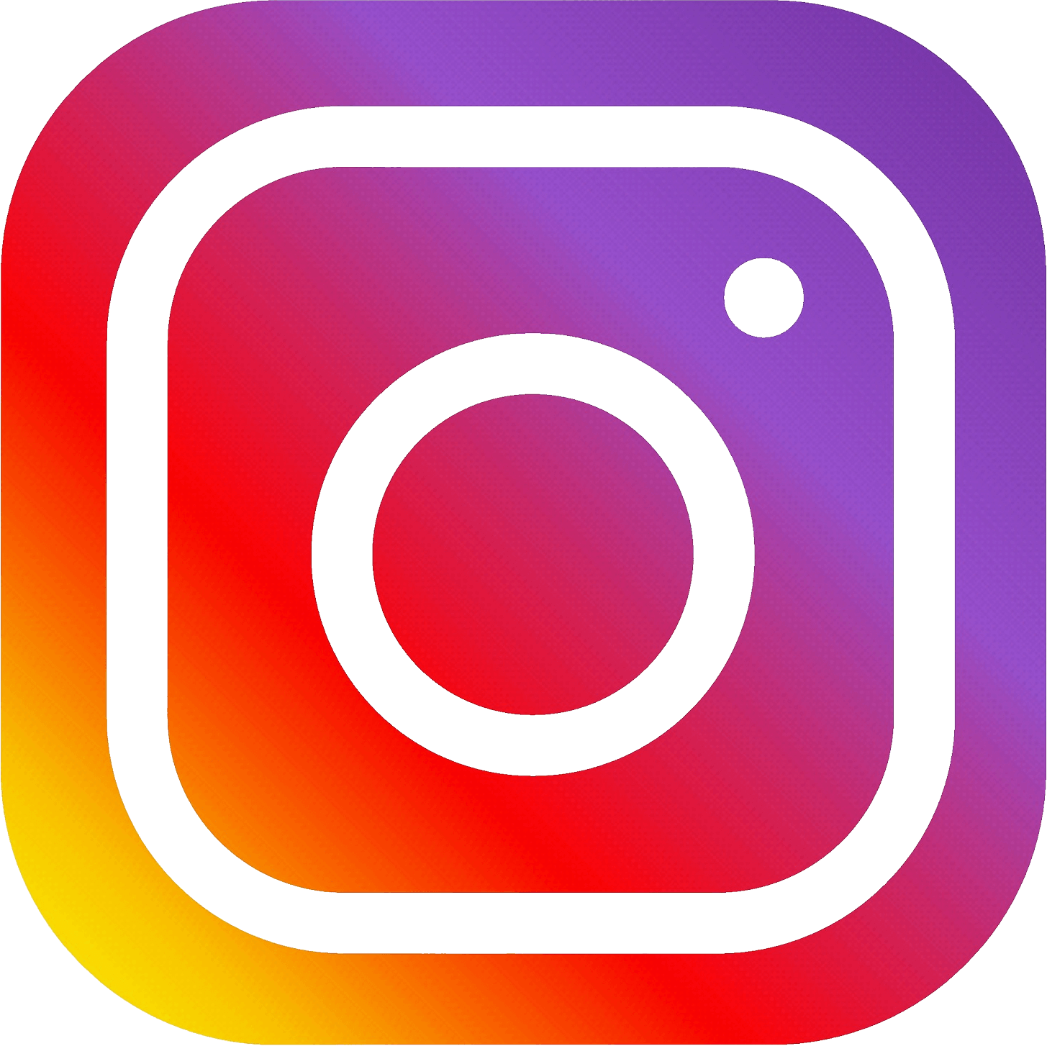




Objectives
Institutions Considered
Approach
Outcome
Institutions Established Year/ Intro.
Questionnaire
Facebook
Instagram
Suggestions
How much time do you spend on each of the platforms in general? (Hours in a day)
Categories
Facebook
Instagram
OTT Platforms
Content Sites
NEWS
Educational Websites
*Assumptions Youngsters are from age group of 18 to 25 & Adults are from age group of above 29
18

Slide 20
Objectives
Institutions Considered
Approach
Outcome
Institutions Established Year/ Intro.
Questionnaire
Facebook
Instagram
Suggestions
How much time do you spend on each of the platforms in general? (Hours in a day)
(Facebook)
Age Group
18-20
21-25
Above 29
According to this research, youngsters (18-20) are not that much active as compared to other age groups and as we proceed further, the respondents are more active. Thus, to target mainly adults the colleges should advertise on Facebook.
19

Slide 21
Objectives
Institutions Considered
Approach
Outcome
Institutions Established Year/ Intro.
Questionnaire
Facebook
Instagram
Suggestions
How much time do you spend on each of the platforms in general? (Hours in a day)
(Instagram)
Age Group
18-20
21-25
Above 29
As seen in the above figure, youngsters are more active on Instagram as compared to Adults. So to target the youngsters Institutes/Colleges should choose Instagram as their first preference.
20

Slide 22
Objectives
Institutions Considered
Approach
Outcome
Institutions Established Year/ Intro.
Questionnaire
Facebook
Instagram
Suggestions
How much time do you spend on each of the platforms in general? (Hours in a day)
(OTT Platform)
Age Group
18-20
21-25
Above 29
OTT Platforms are other great platforms to target young audiences as 24 respondents between the age group of 18-20 are giving time to OTT platforms as compared to adults only 6 respondents in the adult category are giving time.
21

Slide 23
Objectives
Institutions Considered
Approach
Outcome
Institutions Established Year/ Intro.
Questionnaire
Facebook
Instagram
Suggestions
How much time do you spend on each of the platforms in general? (Hours in a day)
(Content Sites)
Age Group
18-20
21-25
Above 29
Most of the respondents don’t give much time on content sites as compared to other sites. But every platform has its own importance. Thus this can’t be overlooked by the institutes.
22

Slide 24
Objectives
Institutions Considered
Approach
Outcome
Institutions Established Year/ Intro.
Questionnaire
Facebook
Instagram
Suggestions
How much time do you spend on each of the platforms in general? (Hours in a day)
(NEWS)
Age Group
18-20
21-25
Above 29
According to this data more youngsters are give time to news apps/sites as compared to adults. But News platforms have a mix of both the age groups. Thus this platform is the most important as from one platform we can target different age group at once.
23

Slide 25
Objectives
Institutions Considered
Approach
Outcome
Institutions Established Year/ Intro.
Questionnaire
Facebook
Instagram
Suggestions
How much time do you spend on each of the platforms in general? (Hours in a day)
(Educational Websites)
Age Group
18-20
21-25
Above 29
This data shows that 45 respondents belonging to the age group of (18-20) are using educational websites. Thus this platform is also very useful for the targeting the young audience and promoting.
24

Slide 26
Objectives
Institutions Considered
Approach
Outcome
Institutions Established Year/ Intro.
Questionnaire
Facebook
Instagram
Suggestions
Which platforms do you visit to get a complete information of a college?
94% of the respondents say that they get the complete information about the college from the college website. Thus the college websites should be up-to-date and all the information should be there. As this can also help in promoting.
25

Slide 27
Objectives
Institutions Considered
Approach
Outcome
Institutions Established Year/ Intro.
Questionnaire
Facebook
Instagram
Suggestions
What are the verticals about which the institutions Advertise/Post on social media platform?
80% of the respondents say that the college is posting mainly In-college activities which is a good part but as we see 0% of the respondents say that college is not posting about the study material. Study material is the most important vertical which can help them to promote.
26

Slide 28
Objectives
Institutions Considered
Approach
Outcome
Institutions Established Year/ Intro.
Questionnaire
Facebook
Instagram
Suggestions
Are you aware that your Institution Posts All In-College activities on social media?
Most of the respondents are aware that the college posts all In-college activities on the social media.
27

Slide 29
Objectives
Institutions Considered
Approach
Outcome
Institutions Established Year/ Intro.
Questionnaire
Facebook
Instagram
Suggestions
Any suggestions regarding digital platform for institution improvement.
Need to maintain a record of daily works that covered by teachers in the class and those topics that are left to be done in the upcoming lectures in a digitally manner.
They can make different login id for every student so that they can use it regularly or whenever they required. For this institutions must have updated all the work and daily activities that happen in the class
Institutions must Focus more on improving their websites and should optimize their sites for mobile platforms. Social media accounts should also be updated constantly with relevant posts and updates.
Updates for any events and workshops with proper information.
28

Slide 30
Objectives
Institutions Considered
Approach
Outcome
Institutions Established Year/ Intro.
Questionnaire
Facebook
Instagram
Suggestions
FACEBOOK
29

Slide 31
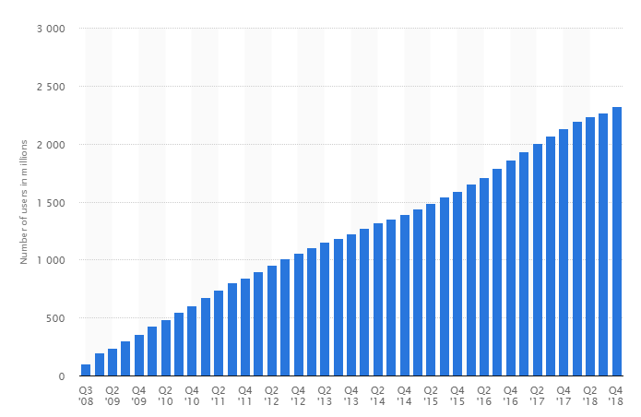
Objectives
Institutions Considered
Approach
Outcome
Institutions Established Year/ Intro.
Questionnaire
Facebook
Instagram
Suggestions
Number of monthly active Facebook users worldwide as of 4th quarter 2018 (in millions)
2.27 billion
https://www.statista.com/statistics/264810/number-of-monthly-active-facebook-users-worldwide/
30

Slide 32
Objectives
Institutions Considered
Approach
Outcome
Institutions Established Year/ Intro.
Questionnaire
Facebook
Instagram
Suggestions
Why Institutes use Facebook as a medium for Promotion?
Facebook is a low-cost marketing strategy.
Viral Promotion- People can like, share your business page, services, and posts on Facebook. If they’re really influenced by your brand message and activities they invite others to like your business page which can have a cascading effect on traffic numbers and make your posts go viral.
Facebook is mainly a text oriented with a combination of Image and video base social platform as compare to Instagram it is only image or video base platform.
Targeted Advertising.
31

Slide 33
Objectives
Institutions Considered
Approach
Outcome
Institutions Established Year/ Intro.
Questionnaire
Facebook
Instagram
Suggestions
Why Institutes use Facebook as a medium for Promotion?
Provide Customer Support- Customers can post questions on your Facebook wall, and your staff can answer them there.
Extensive Analytics- Facebook also doesn’t skimp on analytics and reporting for ad performance. Instead of struggling to see your conversion rate and other social metrics, you have it laid clearly out in front of you.
Facebook can analyze all the information that millions of users enter into their profiles. As the owner of a business page, you can pay to use this information to deliver targeted advertising to a specific group.
Raise brand awareness and promote positive word-of-mouth.
32

Slide 34
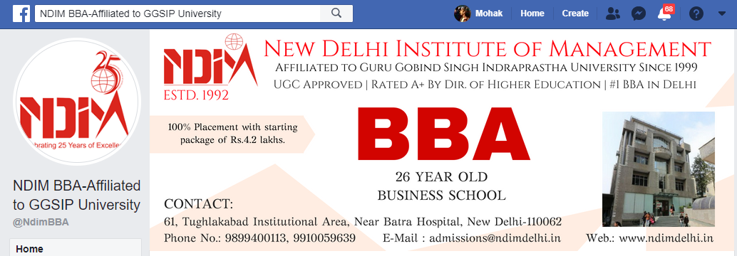
Objectives
Institutions Considered
Approach
Outcome
Institutions Established Year/ Intro.
Questionnaire
Facebook
Instagram
Suggestions
NDIM Facebook Page
https://www.facebook.com/NdimBBA/?ref=page_internal
33

Slide 35
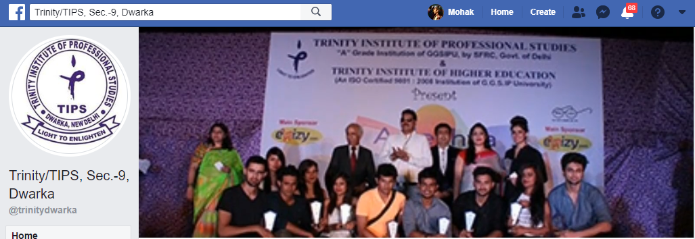
Objectives
Institutions Considered
Approach
Outcome
Institutions Established Year/ Intro.
Questionnaire
Facebook
Instagram
Suggestions
TIPS Facebook Page
https://www.facebook.com/trinitydwarka/?ref=page_internal
34

Slide 36
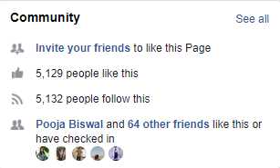
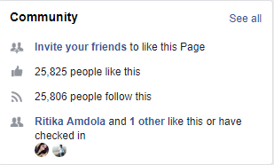
Objectives
Institutions Considered
Approach
Outcome
Institutions Established Year/ Intro.
Questionnaire
Facebook
Instagram
Suggestions
Followers and Likes of each institution
NDIM
TIPS
35

Slide 37
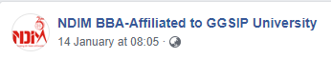
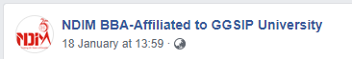
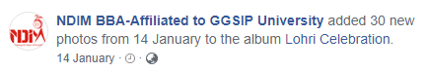
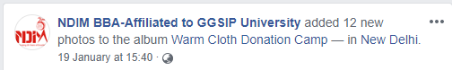
Objectives
Institutions Considered
Approach
Outcome
Institutions Established Year/ Intro.
Questionnaire
Facebook
Instagram
Suggestions
Frequency of Post by NDIM (Weekly)
NDIM is very active on Facebook. They are posting around 3-5 post per week.
36

Slide 38
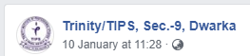
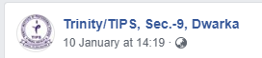
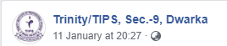
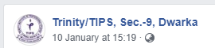

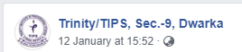
Objectives
Institutions Considered
Approach
Outcome
Institutions Established Year/ Intro.
Questionnaire
Facebook
Instagram
Suggestions
Frequency of Post by TIPS (Weekly)
TIPS is very active on Facebook. They are posting around 4-7 post per week.
37

Slide 39

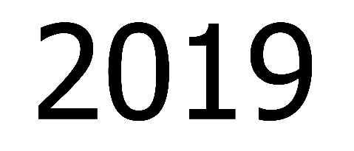


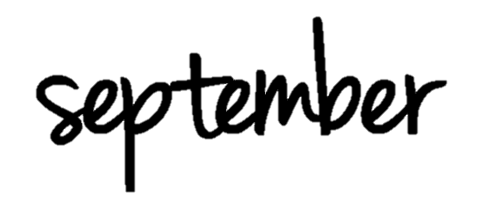
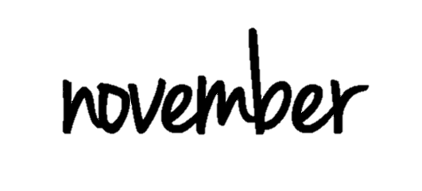




Objectives
Institutions Considered
Approach
Outcome
Institutions Established Year/ Intro.
Questionnaire
Facebook
Instagram
Suggestions
Frequency of Post by NDIM (Monthly)
8
10
12
13
9
3
13
38

Slide 40

Objectives
Institutions Considered
Approach
Outcome
Institutions Established Year/ Intro.
Questionnaire
Facebook
Instagram
Suggestions
Frequency of Post by TIPS (Monthly)
8
12
21
24
7
11
36
39

Slide 41
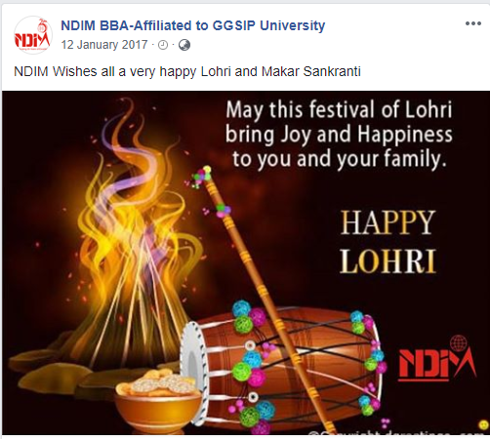

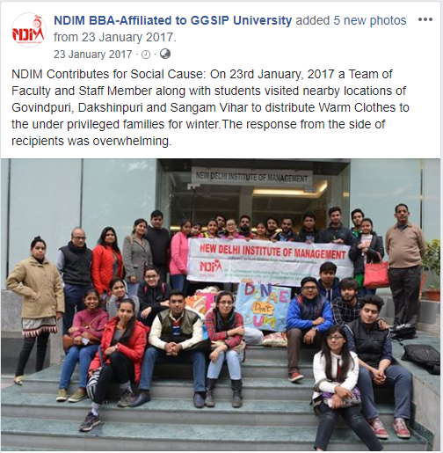
Objectives
Institutions Considered
Approach
Outcome
Institutions Established Year/ Intro.
Questionnaire
Facebook
Instagram
Suggestions
Content Mix of NDIM
Topical Post
Topical Post
In-college activities
40

Slide 42
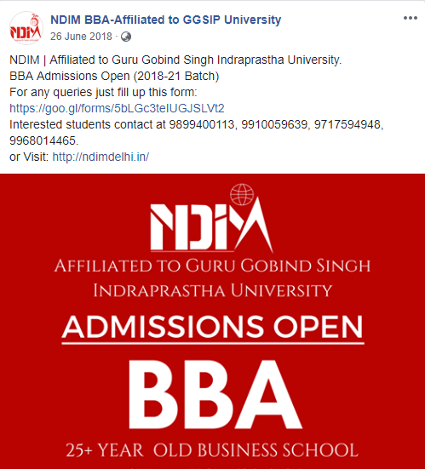

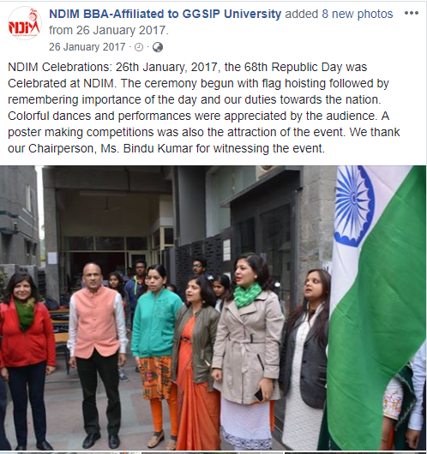
Objectives
Institutions Considered
Approach
Outcome
Institutions Established Year/ Intro.
Questionnaire
Facebook
Instagram
Suggestions
Content Mix of NDIM
Brand/ Product Post
Informative Post
Topical Post
41

Slide 43
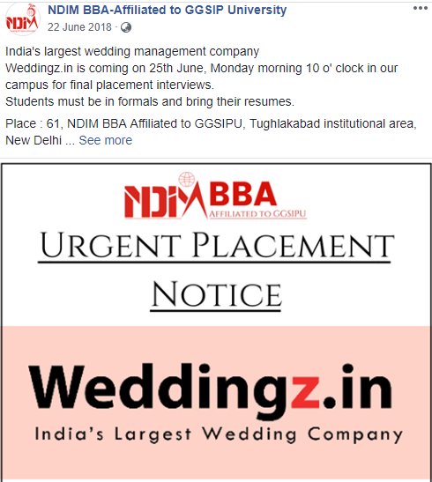
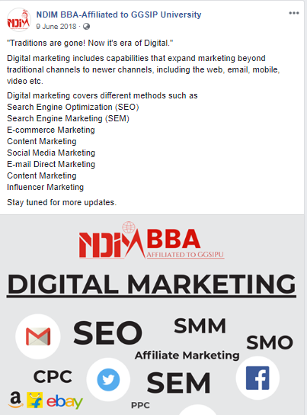
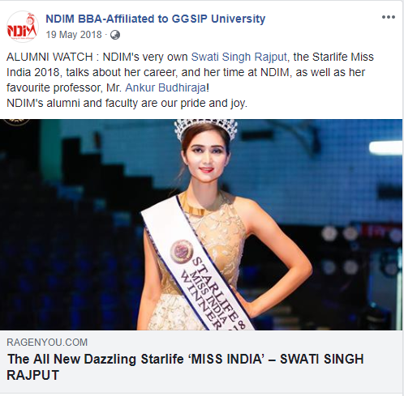
Objectives
Institutions Considered
Approach
Outcome
Institutions Established Year/ Intro.
Questionnaire
Facebook
Instagram
Suggestions
Content Mix of NDIM
Placement Post
Informative Post
Alumni Post
42

Slide 44
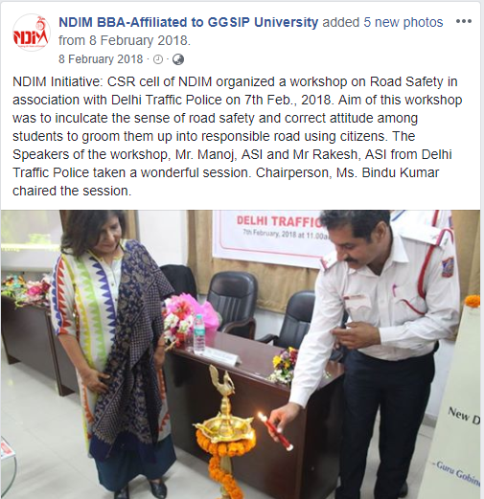
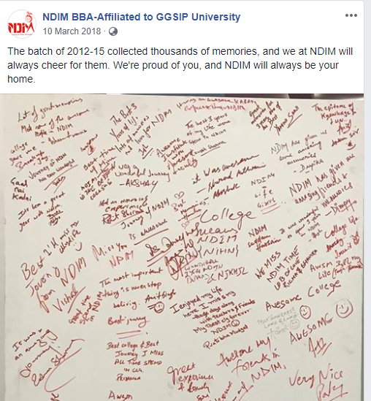
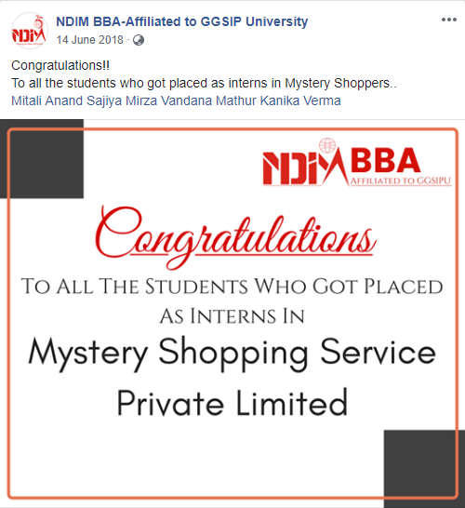
Objectives
Institutions Considered
Approach
Outcome
Institutions Established Year/ Intro.
Questionnaire
Facebook
Instagram
Suggestions
Content Mix of NDIM
Seminar Post
Alumni Post
Placement Post
43

Slide 45
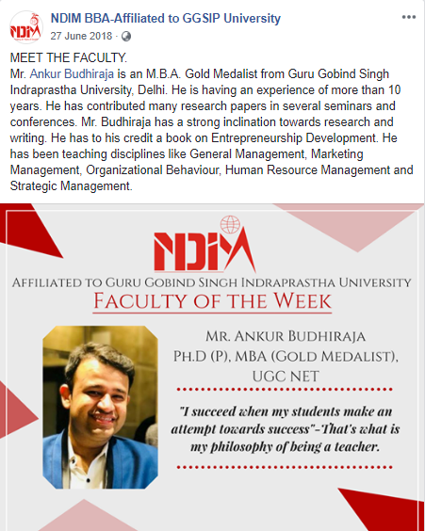
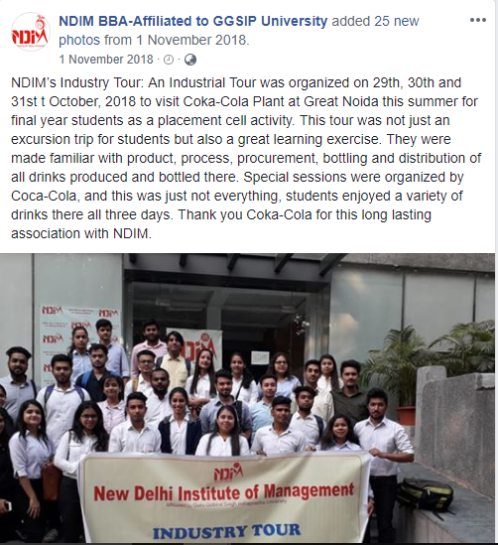
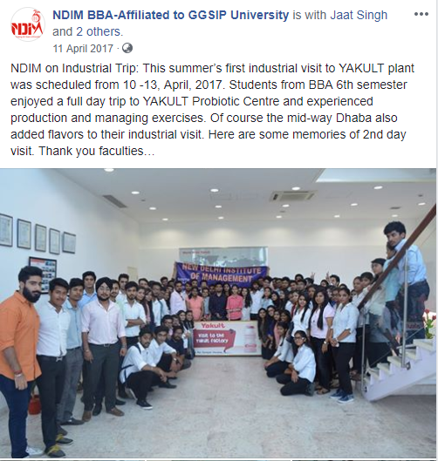
Objectives
Institutions Considered
Approach
Outcome
Institutions Established Year/ Intro.
Questionnaire
Facebook
Instagram
Suggestions
Content Mix of NDIM
Industrial Post
Industrial Post
Faculty Recognition Post
44

Slide 46
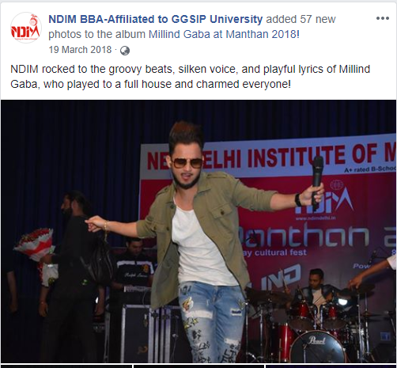
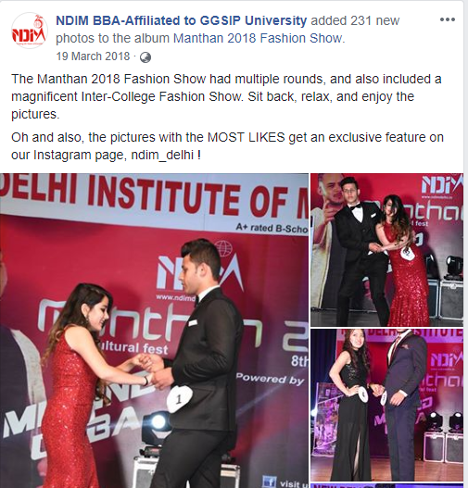
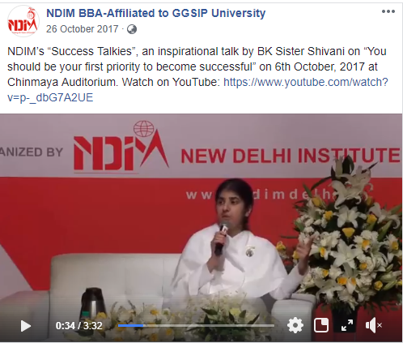
Objectives
Institutions Considered
Approach
Outcome
Institutions Established Year/ Intro.
Questionnaire
Facebook
Instagram
Suggestions
Content Mix of NDIM
Cultural Post
Cultural Post
https://www.facebook.com/NdimBBA/videos/1537235056359507/
45

Slide 47
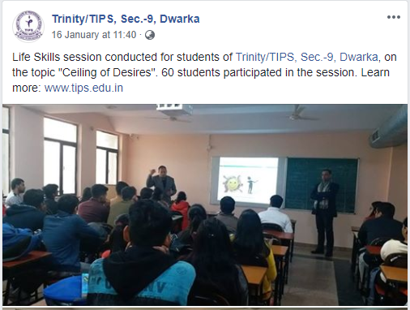
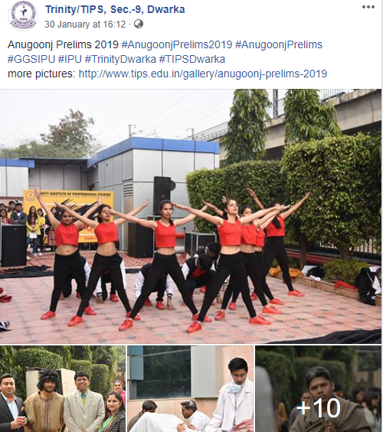
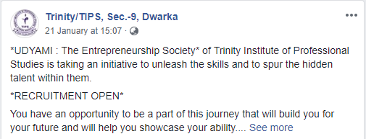
Objectives
Institutions Considered
Approach
Outcome
Institutions Established Year/ Intro.
Questionnaire
Facebook
Instagram
Suggestions
Content Mix of TIPS
Informative Post
Seminar Post
Cultural Post
46

Slide 48
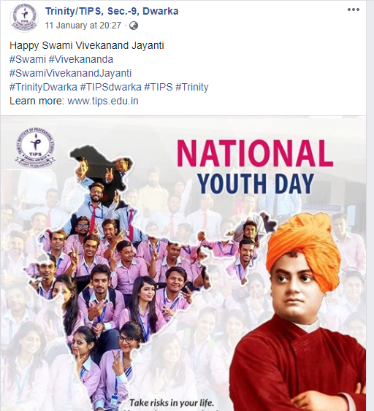
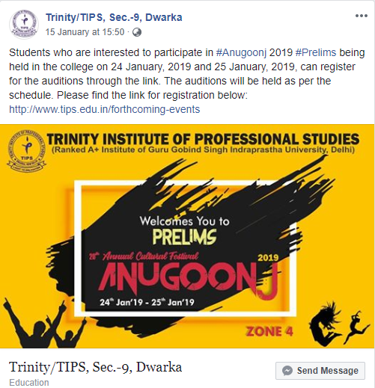
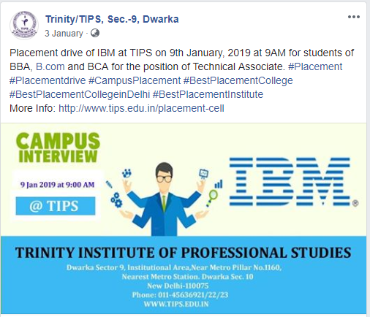
Objectives
Institutions Considered
Approach
Outcome
Institutions Established Year/ Intro.
Questionnaire
Facebook
Instagram
Suggestions
Content Mix of TIPS
Placement Post
Topical Post
Cultural Post
47

Slide 49
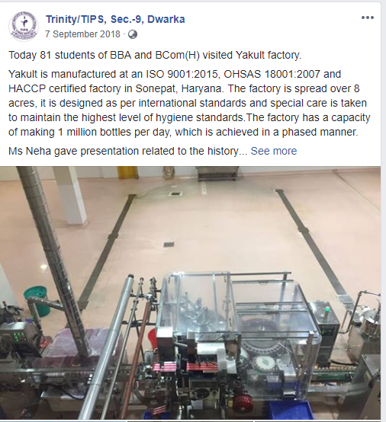
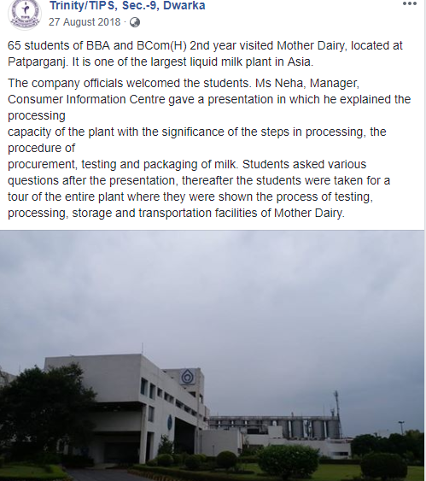
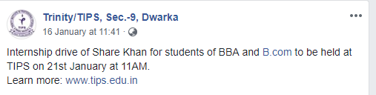
Objectives
Institutions Considered
Approach
Outcome
Institutions Established Year/ Intro.
Questionnaire
Facebook
Instagram
Suggestions
Content Mix of TIPS
Placement Post
Industrial Post
Industrial Post
48

Slide 50
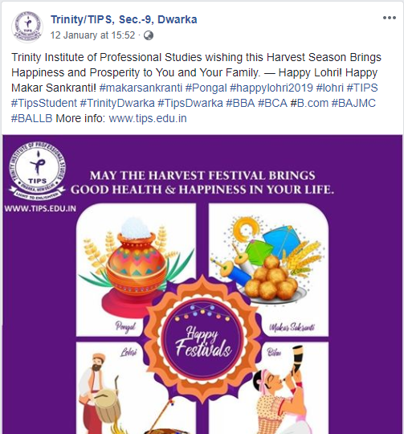
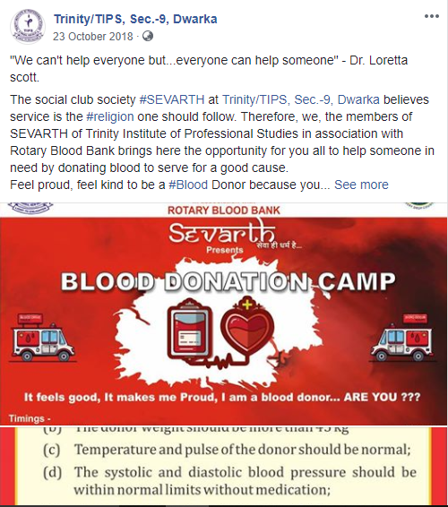
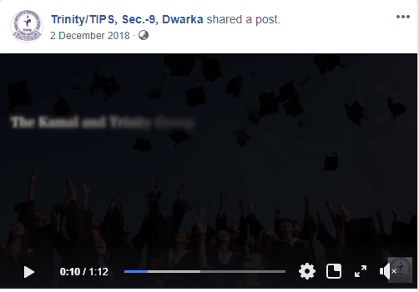
Objectives
Institutions Considered
Approach
Outcome
Institutions Established Year/ Intro.
Questionnaire
Facebook
Instagram
Suggestions
Content Mix of TIPS
Video Post
Topical Post
In-college Activities
49

Slide 51
Objectives
Institutions Considered
Approach
Outcome
Institutions Established Year/ Intro.
Questionnaire
Facebook
Instagram
Suggestions
Summary for the Facebook Page (NDIM Vs TIPS)
According to the research TIPS is more active on Facebook page as compare to NDIM.
TIPS is posting a good mix of both image and video post as compare to NDIM. NDIM is also post video but not in good quantity.
TIPS is having more followers on Facebook Page as compare NDIM.
NDIM and TIPS are post every activity which is happing in the college like:- (industrial trip, blood donation camp, social cause activity and their respected college fests and many more).
50

Slide 52
Objectives
Institutions Considered
Approach
Outcome
Institutions Established Year/ Intro.
Questionnaire
Facebook
Instagram
Suggestions
Summary Continues…
The general content mix which they are using is brand post, topical post and product post.
Both the colleges give importance to Alumni and post their respective achievements.
Facebook was launched on 4th Feb, 2004 and has 2.27 billion active users.
51

Slide 53
Objectives
Institutions Considered
Approach
Outcome
Institutions Established Year/ Intro.
Questionnaire
Facebook
Instagram
Suggestions
Suggestions for the Facebook Page to NDIM
• The most important suggestion for Facebook page is to improve the cover page. They can show the picture of their building on half of the cover page and information on the rest of the page or they can upload a video of campus tour which will help the college to gain more traction or viewer engagement.
• Achievement post/ Gist post (College achievement or Alumni Achievement) should be there in every 2 months or 3 months.
• As NDIM is doing honors by admiring the “faculty of the week” they should continue these types of the posts as they can bring engagement and these type of post can also help students to understand the college. Also they can post about “student of the week” so that students think they are also important in creating the organization/college.
52

Slide 54
Objectives
Institutions Considered
Approach
Outcome
Institutions Established Year/ Intro.
Questionnaire
Facebook
Instagram
Suggestions
Suggestions Continues…
• NDIM can select days like National Science Day (February 28th), World Theatre Day (for Dramatics society) (March 24th), International Dance Day (for the Dance society) (April 29th), International Literacy Day (September 8th) which are less known in India and promote heavily so as to break the clutter which happens on more topical days like Women Day, Republic Day etc.
• The logo size can be decreased so that all the information can be seen in a proper way.
• All society pages of NDIM should be linked with the main Facebook page. So that it will help in increasing engagement and followers both at the same time.
• They should also add links to their Instagram page and YouTube page on Facebook.
53

Slide 55
Objectives
Institutions Considered
Approach
Outcome
Institutions Established Year/ Intro.
Questionnaire
Facebook
Instagram
Suggestions
Suggestions Continues…
• The most important post should be pinned to the top. So that it can easily be viewed.
• NDIM Should use hashtag to make posts to increase their reach.
• They can also use the event tab in the Facebook page so that all the event can be seen on the Facebook page easily.
54

Slide 56
Objectives
Institutions Considered
Approach
Outcome
Institutions Established Year/ Intro.
Questionnaire
Facebook
Instagram
Suggestions
Instagram
55

Slide 57
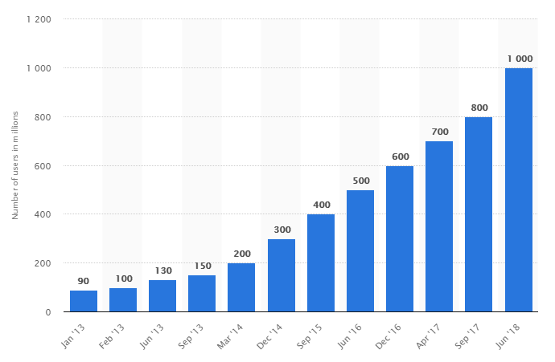
Objectives
Institutions Considered
Approach
Outcome
Institutions Established Year/ Intro.
Questionnaire
Facebook
Instagram
Suggestions
Number of monthly active Instagram users from January 2013 to June 2018 (in millions)
1 billion
https://www.statista.com/statistics/253577/number-of-monthly-active-instagram-users/
56

Slide 58
Objectives
Institutions Considered
Approach
Outcome
Institutions Established Year/ Intro.
Questionnaire
Facebook
Instagram
Suggestions
Why Institutes use Instagram as a medium for promotion
• Visual Content- The visual nature of Instagram makes it an ideal platform for showcasing institutions.
• Increased Engagement- The engagement rate on Instagram is higher than any other social media platform. Latest study by Forrester found that Instagram content generates 58 times more engagement per follower than Facebook and 120 times more than Twitter.
• In terms of ROI and cost, Instagram returns the best results. It’s effective and less time-consuming than other online marketing channels.
• Feed Other Social Media Efforts- Instagram allows to share a post on other social media platforms instantly through its built-in feature. This can be done by going into your Instagram settings and enable sharing to Facebook and Twitter. This will ensure that your Instagram visual is reaching users on other sites as well.
57

Slide 59
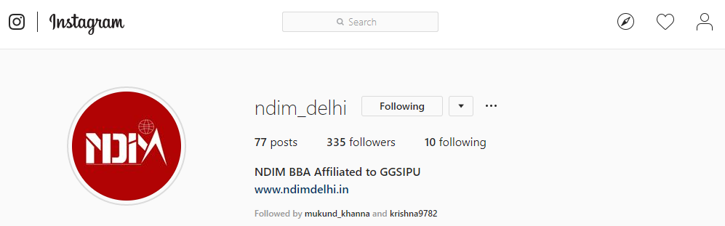
Objectives
Institutions Considered
Approach
Outcome
Institutions Established Year/ Intro.
Questionnaire
Facebook
Instagram
Suggestions
NDIM Instagram Page/ Followers
https://www.instagram.com/ndim_delhi/?hl=en
58

Slide 60
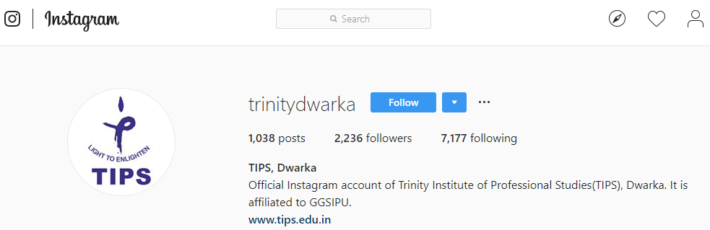
Objectives
Institutions Considered
Approach
Outcome
Institutions Established Year/ Intro.
Questionnaire
Facebook
Instagram
Suggestions
TIPS Instagram Page/ Followers
https://www.instagram.com/trinitydwarka/?hl=en
59

Slide 61






Objectives
Institutions Considered
Approach
Outcome
Institutions Established Year/ Intro.
Questionnaire
Facebook
Instagram
Suggestions
Frequency of Post by NDIM (Weekly)
NDIM is not very active on Instagram. They are posting around 1-2 post per week.
60

Slide 62








Objectives
Institutions Considered
Approach
Outcome
Institutions Established Year/ Intro.
Questionnaire
Facebook
Instagram
Suggestions
Frequency of Post by TIPS (Weekly)
TIPS is active on Instagram. They are posting around 2-5 post per week.
61

Slide 63


Objectives
Institutions Considered
Approach
Outcome
Institutions Established Year/ Intro.
Questionnaire
Facebook
Instagram
Suggestions
Frequency of Post by NDIM (Monthly)
1
1
0
2
0
18
As NDIM stopped posting for a while on Instagram. So, there is no data between November to January.
62

Slide 64
Objectives
Institutions Considered
Approach
Outcome
Institutions Established Year/ Intro.
Questionnaire
Facebook
Instagram
Suggestions
Frequency of Post by TIPS (Monthly)
4
4
6
6
1
3
36
63

Slide 65


Objectives
Institutions Considered
Approach
Outcome
Institutions Established Year/ Intro.
Questionnaire
Facebook
Instagram
Suggestions
Content Mix of NDIM
Cultural Post
Topical Post
64

Slide 66


Objectives
Institutions Considered
Approach
Outcome
Institutions Established Year/ Intro.
Questionnaire
Facebook
Instagram
Suggestions
Content Mix of NDIM
Cultural Post
Topical Post
65

Slide 67


Objectives
Institutions Considered
Approach
Outcome
Institutions Established Year/ Intro.
Questionnaire
Facebook
Instagram
Suggestions
Content Mix of NDIM
Achievement Post
Seminar post
66

Slide 68


Objectives
Institutions Considered
Approach
Outcome
Institutions Established Year/ Intro.
Questionnaire
Facebook
Instagram
Suggestions
Content Mix of NDIM
In-college Activity Post
Seminar Post
67

Slide 69


Objectives
Institutions Considered
Approach
Outcome
Institutions Established Year/ Intro.
Questionnaire
Facebook
Instagram
Suggestions
Content Mix of NDIM
Alumni Post
Alumni Post
68

Slide 70


Objectives
Institutions Considered
Approach
Outcome
Institutions Established Year/ Intro.
Questionnaire
Facebook
Instagram
Suggestions
Content Mix of TIPS
Achievement Post
Informative Post
69

Slide 71


Objectives
Institutions Considered
Approach
Outcome
Institutions Established Year/ Intro.
Questionnaire
Facebook
Instagram
Suggestions
Content Mix of TIPS
Placement Post
Alumni Post
70

Slide 72


Objectives
Institutions Considered
Approach
Outcome
Institutions Established Year/ Intro.
Questionnaire
Facebook
Instagram
Suggestions
Content Mix of TIPS
Achievement Post
Faculty Recognition Post
71

Slide 73


Objectives
Institutions Considered
Approach
Outcome
Institutions Established Year/ Intro.
Questionnaire
Facebook
Instagram
Suggestions
Content Mix of TIPS
Industrial Post
Placement Post
72

Slide 74


Objectives
Institutions Considered
Approach
Outcome
Institutions Established Year/ Intro.
Questionnaire
Facebook
Instagram
Suggestions
Content Mix of TIPS
Topical Post
Topical Post
73

Slide 75
Objectives
Institutions Considered
Approach
Outcome
Institutions Established Year/ Intro.
Questionnaire
Facebook
Instagram
Suggestions
Summary for the Instagram Page (NDIM Vs TIPS)
Instagram was launched on 6th Oct, 2010 and has 1 billion active users.
TIPS is also active on Instagram as they are active on Facebook. But NDIM is not that active on Instagram as compared to their Facebook page.
TIPS uploads their most of the College activities on their Instagram page but NDIM is not posting their activities on Instagram rather they are posting it on their Facebook page.
TIPS has more follower base as compared to the NDIM. This is because TIPS is very active on Instagram too.
74

Slide 76
Objectives
Institutions Considered
Approach
Outcome
Institutions Established Year/ Intro.
Questionnaire
Facebook
Instagram
Suggestions
Suggestions for the Instagram Page to NDIM
• NDIM is not posting any Informative post on Instagram as compare to TIPS. Every platform is different so if NDIM will post activities from current scenarios they can gain engagement and traffic on their page which will help to grow their follower base.
• They can give their other social media platform links also in the intro section of Instagram.
• They should use more Instagram as it provides easy posting on other social media. It will also save a lot of time as Instagram allows to share a post on other social media platforms instantly through its built-in feature like on (Facebook, Twitter, Tumblr).
• Logos should be same throughout the social media platforms. Like Instagram is showing a different logo as compare to Facebook.
75

Slide 77
Objectives
Institutions Considered
Approach
Outcome
Institutions Established Year/ Intro.
Questionnaire
Facebook
Instagram
Suggestions
Suggestions Continues…
• NDIM should post/ cover all in-college activities as Instagram today’s world more active users as compare to Facebook.
• They can also save the stories on the Instagram for the future purposes as it will help the future traffic to get update without completely going through the Instagram page. And this is also the latest update from Instagram so not many institute are using this feature of Instagram.
• NDIM can also repost the “Faculty of the week” post which they are posting on Facebook. As to can more engagement as they have a very low follower base on Instagram as compare to Facebook.
76

Slide 78
Objectives
Institutions Considered
Approach
Outcome
Institutions Established Year/ Intro.
Questionnaire
Facebook
Instagram
Suggestions
Overall Suggestions for the NDIM institute
• OTT platform can be an upcoming platform for advertising/promotion of academic institutions and to target the youngsters of age group (18-20). As from the research, it is proved that there is a lot of footfall of the users on OTT platforms and this is the best platform for advertisement/promotion as individuals spend lot of time on the platform.
• Institutes can also advertise on educational websites as there are youngsters who use them and for any institute, youngsters are the main target audience. So they can advertise on Meritnation, SlideShare, Shiksha.com etc.
• From the research it is proved that NDIM is not posting anything about study material/Course Content, which is an important vertical as it is a basic requirement for any student. So, to make its digital platform strong, NDIM can post about study material/course content.
• So, to reach up to its level NDIM should try to strength its presence on both the platforms and can follow the suggestions given in context of both these platform (Facebook, Instagram).
77

Slide 79
Thank you

